Slide 1
CS 439 25F Student Assessments Graph Report
Group XX
Member {Name 1} ({NetID 1})
Member {Name 2} ({NetID 2})
Member {Name 3} ({NetID 3})
Date Oct XX, 2025

Slide 2
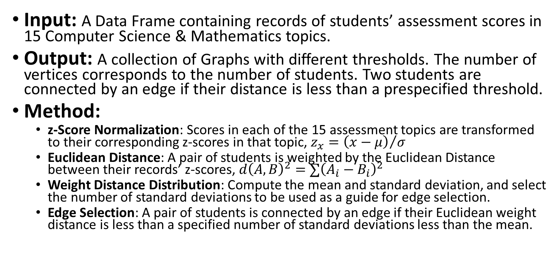
From Data Frames to Graphs
Input: A Data Frame containing records of students’ assessment scores in 15 Computer Science & Mathematics topics.
Output: A collection of Graphs with different thresholds. The number of vertices corresponds to the number of students. Two students are connected by an edge if their distance is less than a prespecified threshold.
Method:
z-Score Normalization: Scores in each of the 15 assessment topics are transformed to their corresponding z-scores in that topic, $z_{x}={\left(x−μ\right)}/σ$
Euclidean Distance: A pair of students is weighted by the Euclidean Distance between their records’ z-scores, $d{\left(A, B\right)}^{2}=∑{\left(A_{i}−B_{i}\right)}^{2}$
Weight Distance Distribution: Compute the mean and standard deviation, and select the number of standard deviations to be used as a guide for edge selection.
Edge Selection: A pair of students is connected by an edge if their Euclidean weight distance is less than a specified number of standard deviations less than the mean.

Slide 3
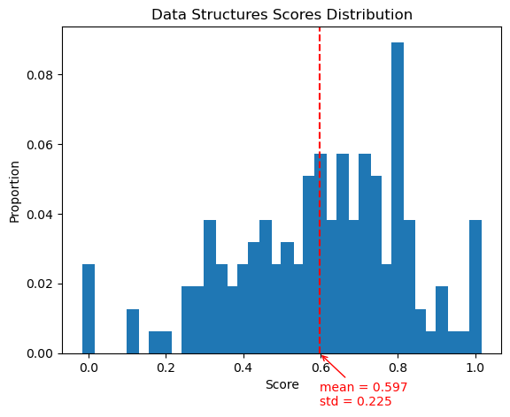

Data Set Description
A short description of Student Assessments Table, Columns, Rows, and Values in each entry. (e.g., each row represents the performance of a student in an assessment questionnaire. Each column …)
For each column of the 15 Computer Science & Mathematics topics, plot the distributions of 0-1 scaled scores and corresponding z-Scores, and annotate the mean and the standard deviation. Label each plot with the corresponding topic name (Sample plots for “data structures”).

Slide 4
Pairwise Euclidean Students Distances
Global histogram of pairwise Euclidean Students distances
Global histogram of pairwise Euclidean Students distances, z-Score normalized
pairwise Euclidean Students distances
pairwise Euclidean Students distances, z-Score normalized
Proportion
Proportion
0
Students Distances
0
z-Score Normalized Distances

Slide 5
Student_Assessment_Graph_-xSD
Student_Assessment_Graph_-xSD
For each constructed graph
|V| =
|E| =
Does this graph degree distribution look like a Power Law graph?
Top 10% students’ NetIDs and total_scores
|cc| =
Create a scatter plot, where each dot represents the number of cc with a fixed vertex size and edge size.
1
Proportion
0
Degree Distribution
deg
Student_Assessment_Graph_-xSD
|E|
Dot size proportional to # cc of (|V_{cc}|, |E_{cc}|)
CC Edge Size
0
CC Vertex Size
|V|

Slide 6
Layouts of Student_Assessment_Graph_-3SD
For each constructed graph, draw the three force-directed graph layouts.
NetworkX.spring_layout()
JavaScript 2D Force Graph
JavaScript 3D Force Graph
Student_Assessment_Graph_-3SD
Student_Assessment_Graph_-3SD
Student_Assessment_Graph_-3SD

Slide 7
Layouts of Student_Assessment_Graph_-2SD
For each constructed graph, draw the three force-directed graph layouts.
NetworkX.spring_layout()
JavaScript 2D Force Graph
JavaScript 3D Force Graph
Student_Assessment_Graph_-2SD
Student_Assessment_Graph_-2SD
Student_Assessment_Graph_-2SD

Slide 8
Layouts of Student_Assessment_Graph_-1SD
For each constructed graph, draw the three force-directed graph layouts.
NetworkX.spring_layout()
JavaScript 2D Force Graph
JavaScript 3D Force Graph
Student_Assessment_Graph_-1SD
Student_Assessment_Graph_-1SD
Student_Assessment_Graph_-1SD

Slide 9
Observations
Do the graphs exhibit visible “clusters” of similar students? Specify the “clusters” of students you found by listing their NetIDs sorted alphabetically in non-decreasing order.
 | NetID 1 | NetID 2 | NetID 3 | …
Cluster 1
Cluster 2
Cluster 3
…

Slide 10
Findings
Review the students in the same detected “cluster” in terms of their skill proficiency scores. Do they have “similar” high scores in certain subsets of skill proficiencies? How could you argue that your selected “clusters” of students are meaningful?

Slide 11
References
List the libraries, tools, and book references used in this assignment.
You may use this online tool to convert the corresponding bibtex to the corresponding ACM citation format (example below).
Sample bibtex:
@InProceedings{SciPyProceedings_11,
author = {Aric A. Hagberg and Daniel A. Schult and Pieter J. Swart},
title = {Exploring Network Structure, Dynamics, and Function using NetworkX},
booktitle = {Proceedings of the 7th Python in Science Conference},
pages = {11 - 15},
address = {Pasadena, CA USA},
year = {2008},
editor = {Ga\"el Varoquaux and Travis Vaught and Jarrod Millman},
}
Sample ACM citation:
Aric A. Hagberg, Daniel A. Schult, and Pieter J. Swart. 2008. Exploring Network Structure, Dynamics, and Function using NetworkX. In Proceedings of the 7th Python in Science Conference, Pasadena, CA USA, 11–15.

